Slide 2
AGENDA
1. HISTORY AND SURVEY DESIGN OF LFS IN TÜRKİYE
2. HISTORY OF URBAN-RURAL STUDIES AT TURKSTAT
3. USING DEGURBA IN LFS
4. CONCLUSION

Slide 3
History of LFS in Türkiye
1966
1988
1995
2000
2004
2014
2020
TurkStat conducted
1st LFS
LFS field application was started to be carried out with CAPI method
LFS has been published annually according to the NUTSII
In addition to the CAPI data collection method, CATI method has been applied and mixed-mode data collection method is started to be implemented
LFS has been implemented regularly by TurkStat
LFS results were published quarterly urban-rural basis and annually on the basis of 7 geographical regions and 9 selected provincial centers
Survey application was started in which not only the first week of the month but all weeks of the year were defined as the reference period

Slide 4
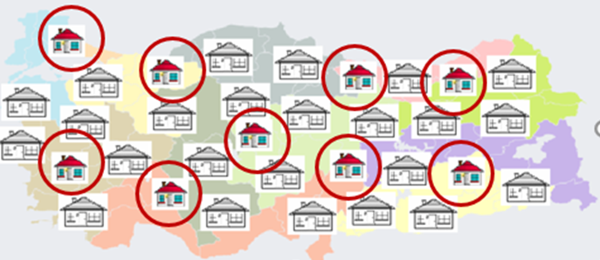
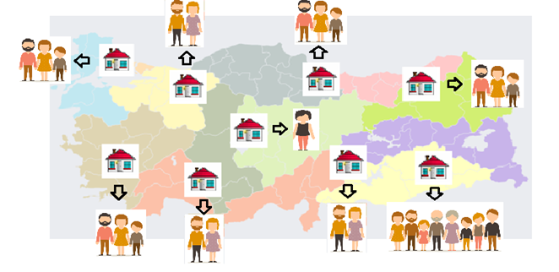
Survey Design of LFS in Türkiye
The sampling unit is the household address and the observation unit is the household. All private households who are residing in the territory of Republic of Türkiye are covered.
Residents of schools, dormitories, kindergartens, rest homes for elderly persons, special hospitals, military barracks and recreation quarters for officers are excluded from the sampling frame.
Households to be interviewed are selected randomly providing a representation of Türkiye per month and quarter, and of NUTSII per year by using two-stage stratified cluster sampling method
Notes:
https://png.pngtree.com/png-vector/20220208/ourlarge/pngtree-turkey-map-with-turkish-flag-3d-shape-isolated-white-vector-png-image_3321191.png

Slide 5
Survey Design of LFS in Türkiye
58,590 households quarterly
semipanel survey
234,360 households annually
equally distributed to the weeks
CAPI-CATI mixed mode
Notes:
https://nipo.com/wp-content/uploads/2024/02/CATI-headset.png

Slide 6
Survey Design of LFS in Türkiye
 | YEAR I |  |  |  | YEAR II
 | Q1 | Q2 | Q3 | Q4 | Q1 | Q2 | Q3 | Q4
1 | A
2 | A | A
3 | B | A | A
4 | B | B | A | A
5 | A | B | B | A | A
6 | A | A | B | B | A | A
7 | B | A | A | B | B | A | A
8 | B | B | A | A | B | B | A | A
9 |  | B | B | A | A | B | B | A
10 |  |  | B | B | A | A | B | B
11 |  |  |  | B | B | A | A | B
12 |  |  |  |  | B | B | A | A
13 |  |  |  |  |  | B | B | A
14 |  |  |  |  |  |  | B | B
15 |  |  |  |  |  |  |  | B
50% overlap between two consecutive quarters and same quarters between consecutive years
SUBSAMPLES
four waves in a 15-month period

Slide 7
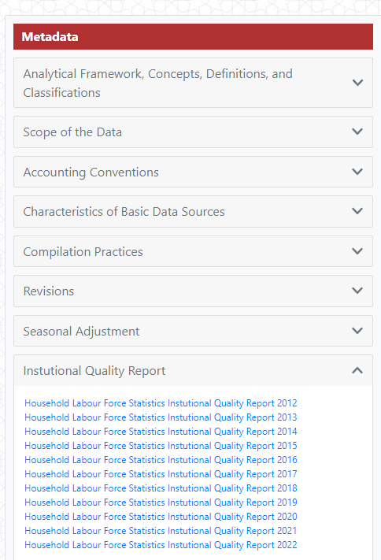
Survey Design of LFS in Türkiye
For detailed information:
TurkStat Web Site (https://www.tuik.gov.tr/Home/Index)
Statistics
Employment, Unemployment and Wages
Press Release → Labour Force Statistics
Metadata → Instutional Quality Report

Slide 8
Survey Design of LFS in Türkiye
Design Weights
the inverse of the selection probabilities
Non-response Adjustment
at cluster level
at household level
External Distribution Controls
Integrative Calibration using mid date projected population distributions
Trimming
Limits: 1/3 - 3
at individual level
Türkiye Age group x Gender
NUTSIII total (81 Provinces)
NUTSII (26 Regions) x Urban-Rural
Türkiye household size
WEIGHTING

Slide 9
History of Urban-Rural Studies at TurkStat

Slide 10
History of Urban-Rural Studies at TurkStat
DEGURBA is based on 1 km² population density grids. Address-Based Population Registration System results and Spatial Address Registration System are the basic data sources, and as a result of their matching, coordinated population data is obtained at the grid level. This information was moved from the grid level to the administrative borders to ensure continuity in TurkStat's current statistical production process. Since the provincial and district levels are insufficient to reflect the urban-rural characteristics, it was deemed appropriate to make urban-rural definitions in three classes at the neighborhood-village level.
Densely Populated Areas
Thinly Populated Areas
Intermediate-density Areas

Slide 11
Using DEGURBA in LFS
In this study, the effect of using DEGURBA definitions on the estimations was examined. All other calibration variables were kept constant and only NUTS2 x DEGURBA Level 1 was used instead of NUTS2 x urban-rural.
To see these effects, twelve monthly data was considered. Using this data, the unemployment rate, employment rate and labor force rate variables, which are among the main labor force indicators, were calculated both in total and by gender.
*Months are randomly ranked from 1 to 12 according to the magnitude of change.

Slide 12
Using DEGURBA in LFS
When the annual data was analyzed by sector, it was seen that the most striking sector was agriculture. The variation in estimates for the agricultural sector is given in the NUTS2 regional breakdown. It is seen that there are serious differences in the agricultural sector estimates obtained after the transition to DEGURBA.
*The regions are randomly ranked from 1 to 26 according to the magnitude of change.

Slide 13
Conclusion
The previous twelve monthly independent main estimates (Labour force, Employment, Unemployment, Not in labour force) were compared in total level and seen that the maximum difference is around 3%. Agricultural sector estimates were also examined based on yearly data since it was thought that the change in the definition of rural area would affect this sector.
In conclusion, the projected population distributions based on the new definition were obtained, then the respondent LFS data was re-coded according to new urban-rural definition. Afterwards, the data entered the calibration process with these reclassification and new projected populations.
It should be noticed that this is an indirect approach and the analysis were made on main indicators not on the more detailed indicators. In light of these developments, it is planned to restart publishing estimates on a urban-rural (DEGURBA level 1) breakdown in the coming years.

Slide 14
Statistics are key to understanding the past,
managing today
and planning for the future.

Slide 15
25th APRIL TURKISH STATISTICS DAY

