Slide 1
Possible improvements in the estimation of IT-LFS through integration with the registers system
25-26 April 2024, Neuchâtel-Switzerland
17th Workshop on Labour Force Survey Methodology
Alessandro Martini
Istat | Italy

Slide 2
Index
Background
Micro-linkage of administrative information and LFS data
Use of calibration and administrative information for Non-response treatment
Additional benchmarks derived from administrative and statistical registers
Application and results
Conclusions
2

Slide 3
Background
The Italian Labour Force Survey (LFS) offers monthly, quarterly, and yearly figures, including flow estimates.
Its sample is uniformly spread across all weeks such that all geographical domains are represented in each month and in each wave (rotational group).
Consistency of estimates produced by different sources is a key quality dimension for NSIs, ISTAT needs to ensure coherency between LFS and different other households surveys (AVQ-ICT, TUS, IT-Silc) and also with Continuous Population Census.
In this presentation we focus on the evaluation of possible improvements on the accuracy of the estimates produced by IT-LFS, and their coherence with Census, exploiting the integration of auxiliary information coming from the ISTAT system of administrative and statistical registers (SIM).
“Coherence by design” is the idea of ensuring consistency trough the harmonization of sampling frames, designs, estimation methods and data collection protocols.
3

Slide 4
Three-step weighting procedure
the inverse of the inclusion probabilities of any selected household
Step 1
Initial weights
initial weights multiplied by non-response correction factors (as the inverse of the response ratios)
Step 2
Intermediate weights
Correction factors are calculated using the information from the LFS theoretical sample in order to have more robust estimates of 13 household typologies, considering the age, gender, citizenship of the head of the household and the number of members. When we started this kind of correction for non-response, this information was not available in the population frame, but only for the municipalities selected in the sample.
obtained solving a calibration model, minimizing the distance between final and intermediate weights;
the population constraints regard the estimates of some auxiliary variables that have to be equal to the totals in the reference population derived by external sources.
Step 3
Final grossing weights
Final weights ensure that all members of a given household have the same weight.

Slide 5
Weighting scheme
Constrains applied in the quarterly calibration are more detailed then the EU regulation requirements.
The weighting scheme includes:
distribution of population by sex and seventeen 5-year age groups (0-14, 15-19, …, 85-89, 90 and more years), at NUTS II level;
distribution of non-national population broken down by male, females, other EU citizens, Non-EU citizens, at NUTS II level;
number of households for each rotation group (1/4 of the total), at NUTS II level;
distribution of population by sex and five age groups (0-14, 15-29, 30-49, 50-64, 65 and more years), at NUTS III level;
distribution of population by sex and five age groups (0-14, 15-29, 30-49, 50-64, 65 and more years) for the thirteen large municipalities with more than 250.000 inhabitants;
distribution of population by sex, for each of the three months of the quarter, at NUTS II level.
The quarterly weights already establish a benchmark to the NUTS 3 population. Annual datasets are derived by aggregating quarterly interviews, ensuring full coherence between annual and quarterly estimates.
5

Slide 6
Use of calibration and administrative information for Non-response treatment
The availability to link the actual sample to the register data made it possible to review the non-response treatment.
Currently, we derive correction factors from the theoretical LFS sample using an Iterative Proportional Fitting procedure.
With access to population registers, we can directly derive totals for household distribution by specific typologies and geographical domains, bypassing the need for estimates.
The use of calibration allows to define a more flexible framework to avoid very small adjustment cells, organizing constraints in a more flexible framework, for instance applying a more detailed classification of households typologies at NUTS2 domain, a less detailed classifications at NUTS3 domain and strata level.
6

Slide 7
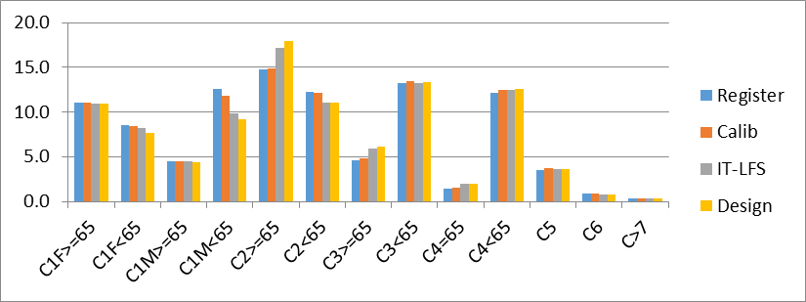
The effectiveness of non-response treatment through calibration and administrative data)
Current procedure doesn't fully correct underestimations for certain household categories:
C2>=65 overestimation;
C1M<65 underestimation;
In the current IPF procedure correction factors at stratum level cannot exceed the values calculated at province.
This was a reasonable criterion and ensured a suitable correction in the past .
The profile of non-response by region and type of municipality has deeply changed and these bounds do not allow an effective treatment of non-response.
Totals directly derived from the population register are likely more reliable than the estimates we can derive from the theoretical sample.

Slide 8
The impact of Covid emergency on the IT-LFS
The Covid emergency had a big impact on the data collection process of IT-LFS; so possible sources of bias arose in the data due to:
  - selection of all households having phone number available;
  - selection of households from respondent to LFS in the past with phone number;
  - higher substitution rate (replacement of non-respondent households);
  - higher final non-response rate.
We studied the bias by comparing 2020 IT-LFS data with previous rounds and administrative sources, noting higher frequencies for elderly, Italian, and higher-educated individuals. To mitigate bias, we introduced additional constraints on education level distribution.
With the January 2021 population data update, we recalculated LFS weights to align with the IT Census, removing education-level constraints, since it was not possible to update these constraints.
However, given the relationship between education level and labour market indicators, we evaluated the effect of integrating auxiliary information on education level from population register (RBI) and the signals of regular employment in the Labour Register (RTL/BOP).
8

Slide 9
Micro-linkage of administrative information and LFS data
In recent years, the availability of data from administrative and statistical registers in Italy has significantly increased, with expectations of further improvements in quality and timeliness.
Until a few months ago, the main obstacle to such integration was represented by the timing and methods of ”pseudonymization” of the actual sample of the LFS survey.
The unique identifier was available for the actual sample only at the end of the year, for the purpose of estimating the informal employment for National Accounts.
Recently, a new semi-automated pseudonymization process has been developed to enable regular integration of administrative data into the LFS.
Based on a probabilistic record linkage methodology, this process successfully assigns a unique code to over 98% of cases, in line with the timeliness required for monthly and quarterly LFS data production.
This offers the opportunity to integrate these data into the estimation process of LFS with the aim of improving treatment of total non-response and enhancing accuracy of the estimates.
9

Slide 10
Additional benchmarks derived from administrative and statistical registers
Population register (RBI) is available referred to year Y-1 for the estimation of quarter YQ4;
  Information available refers to age, sex, municipality of residence, nationality, education level.
Labour Register (RTL/BOP) has almost the same timing but with a provisional version;
  Information available refers to monthly signals of regular employment (employed, not employed).
Integrating the LFS actual sample the same information is available at microdata level, both in the sample and in the total population.
The first set of 24 constraints include education level in 4 groups (ISCED 0-1, 2, 3-4, 5-Higher) by sex, and by 3 age groups (15-29, 30-49, 50+).
The second set of constraints include two different option to consider this auxiliary information:
Total quarterly signals of regular employment for 15-64 individuals by gender;
Annual average of signals of regular employment for 15-64 individuals by gender.
10

Slide 11
Application and results
We compared of different calibration models for quarter 2021Q4 LFS with the results of the census 2021.
All the constraints have been defined at NUTS 2 level, the level of partitioning of our calibration model.
In the census, employment status at time 𝑡 for unit 𝑘 is modelled as a binary latent variable (𝑡, 𝑘) (employed or not).
Coherence of employment estimates are open issue in our country, in particular for the census, that releases its figures 12 months after the reference period, with much less timeliness than then LFS.

Slide 12
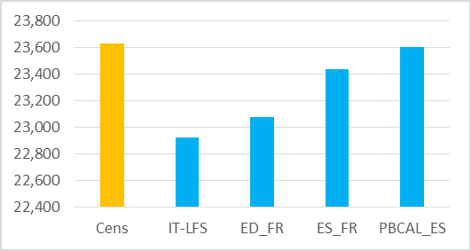
Total Employment Census 2021, LFS 2021Q4 with different weights
Comparing the IT-LFS with the entire census framework (List-sample, Area sample, Register), the LFS shows:
a higher share of respondents with no employment signal in the reference week;
a higher proportion of individuals with university degrees;
a lower percentage of individuals with education up to high school level;
employed people in the LFS that is lower of 3.0% than the census at national level;
Introducing constraints in the calibration derived from the registers, LFS employment estimate increases to :
23.081k including the education level (ED_FR);
23.437k introducing the constraints on regular employment signals (ES_FR);
23.603k recalculating both the intermediate weight with a calibration step and including the constraints coming from the registers in the final weighting step (PBCAL_ES).
12

Slide 13
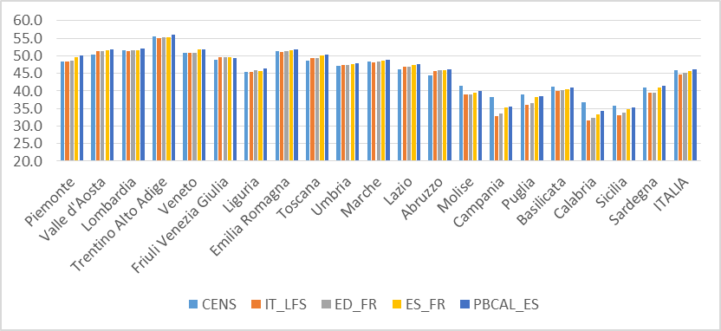
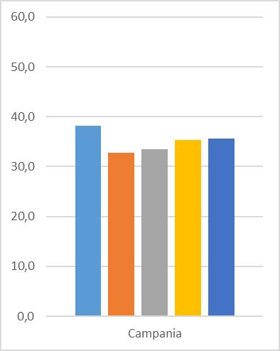
Employment rate 15+ at Nuts2 level, Census 2021, LFS 2021Q4, different weights
For employment rate 15+ at national level we get similar results, coherence with census improves, the last estimate with 2-step calibration almost closes the gap with the census figure.
Nuts2 level analysis points out clearly a regional pattern:
Including the auxiliary information from registers, the employment rate, based on the ILO definition, increases, in particular in the southern regions.
In Campania employment rate raises from 32.8 (the IT-LFS figure) to 33.5% including education level, 35.3% with regular employment signals and to 35.6% with 2-step calibration.
Almost the same happens in Calabria, Sicilia and Puglia.

Slide 14
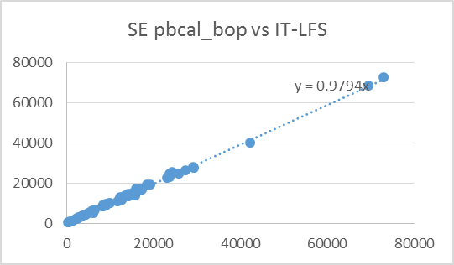
Accuracy improvement with 2-steps calibration
Standard errors for the main aggregates at NUTS2 level, 2021Q4 LFS estimates and 2-step weights
Comparison of standard errors for a set of estimates obtained with 2-step calibration and the current calibration model shows a slight increase for the precision of the estimates with the first option ($\hat{β}=0.979$).

Slide 15
Comparison between Census and LFS in Italy
  These results confirm the differences between Census and LFS in Italy, an open issue that requires to be studied more in depth.
  The response propensity of respondents is different for the two surveys and the under/over coverage as well.
  Historically, the census is able to reach individuals who are very mobile in the country, perhaps a large part of them is residing in the south of the country but lives and works in the northern regions.
  Participation in the census is a strong motivation, in order to maintain residence in a particular municipality.
  The availability of CAWI interviewing mode for the Census can be relevant for this particular subpopulation.
  Participation in the LFS may be more difficult for these individuals, since they spend most of their time away from their registered residences, potentially resulting in underrepresentation in the sample.
  The LFS offers the advantage of shorter data collection periods, which can mitigate telescoping effects and measurement errors.

Slide 16
Conclusions
  It seems reasonable that introducing the same auxiliary information, such as education level and signals of regular employment, already included in the census latent class model, into the calibration model of the LFS, deals to an improvement of the coherence of the estimates.
  Calibration, besides offering efficiency gains, is highly effective in constructing a coherent survey system in specific statistical domains.
  Considering the different timeliness of the two surveys, benchmarking census employment to the LFS figure could be a suitable strategy, once the differences are clearly identified.
  However, the joint use of such auxiliary information in calibration estimators raises several questions:
  Integrating administrative data into the LFS improves the accuracy of monthly and quarterly estimates?
  Including this information can be considered a best practice?
  Which type of signal for regular employment should be considered: quarterly or annual?
  Do they significantly affect the seasonal pattern of ILO Employment?

Slide 17
Thank you
Alessandro Martini alemartini@istat.it

