Slide 2
LFS model-based estimates and variance estimation
John Michiels, Jan van den Brakel

Slide 3
Contents
Sample design of the LFS (historical overview)
GREG-estimation and time-series modelling
Variance estimation in a model-based context

Slide 4
History of the LFS sample design
1987- 2000
2001-2010
2010-2012
2013-2020
CAPI
CAPI
CAPI/CATI
CAWI/CAPI/CATI
CATI
CATI
CATI
CATI
CATI
CATI
CATI
CATI
CATI
CATI
CATI
CATI

Slide 5
Sample design (2021 - ..)
1
Mixed-mode:
- Web (CAWI)
- Telephone (CATI)
- Face-to-face (CAPI)
2
4
5
Mixed-mode:
Mixed-mode:
Mixed-mode:
3
Mixed-mode:
- Web (CAWI)
- Telephone (CATI)
- Web (CAWI)
- Telephone (CATI)
- Web (CAWI)
- Telephone (CATI)
- Web (CAWI)
- Telephone (CATI)

Slide 6
GREG-estimation and time-series modelling

Slide 7
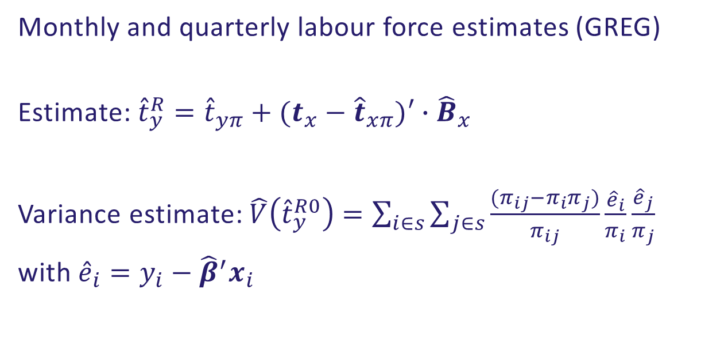
General REGression-estimation (GREG)
Monthly and quarterly labour force estimates (GREG)
Estimate: ${\hat{t}}_{y}^{R}={\hat{t}}_{yπ}+(t_{x}−{\hat{t}}_{xπ})′∙{\hat{B}}_{x}$
Variance estimate: $\hat{V}\left({\hat{t}}_{y}^{R0}\right)=\sum_{i∈s}{\sum_{j∈s}{\frac{(π_{ij}−π_{i}π_{j})}{π_{ij}}}}\frac{{\hat{e}}_{i}}{π_{i}}\frac{{\hat{e}}_{j}}{π_{j}}$
with ${\hat{e}}_{i}=y_{i}−{\hat{β}}^{′}x_{i}$

Slide 8
GREG-estimates unemployed
LFS monthly data: estimates are quite volatile (small sample size)

Slide 9
Workaround
Rolling 3-monthly average

Slide 10
Problems with this approach
Rolling averages lag one month behind
Seasonal patterns are flattened
Month-to-month changes are still inaccurate
Possible solution:
=> Structural time series: borrowing strength over time

Slide 11
Borrowing strength over time
Earlier observations tell something about future developments

Slide 12
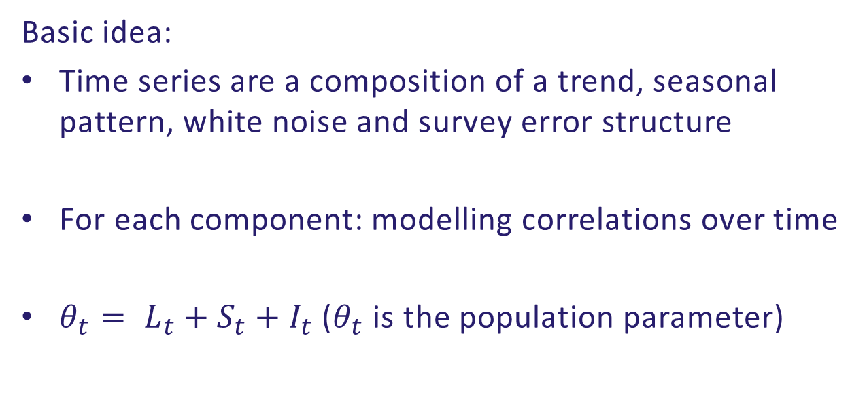
Structural Time series Modelling (STM)
Basic idea:
Time series are a composition of a trend, seasonal pattern, white noise and survey error structure
For each component: modelling correlations over time
$θ_{t}= L_{t}+S_{t}+I_{t}$ ($θ_{t}$ is the population parameter)

Slide 13
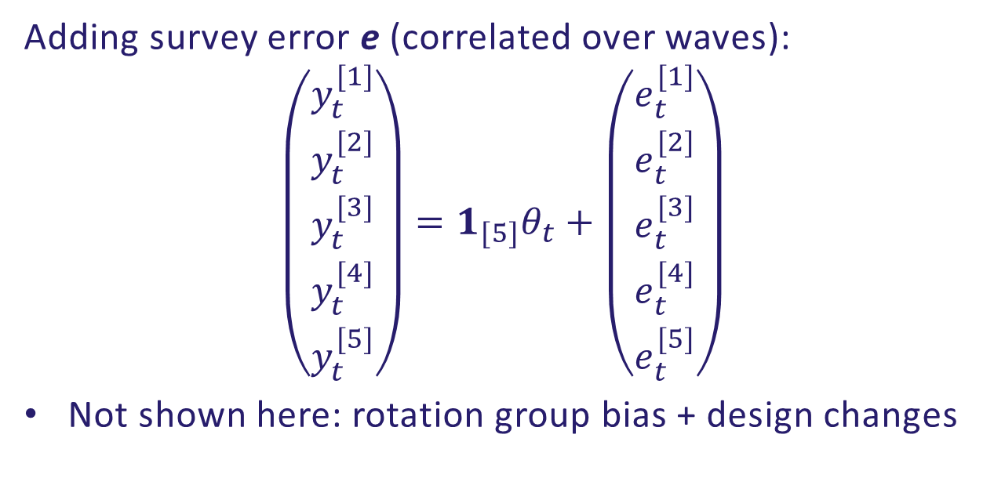
STM: including the survey error component
Adding survey error e (correlated over waves):
$$\left(\begin{matrix}y_{t}^{[1]} \\ \begin{matrix}y_{t}^{[2]} \\ y_{t}^{[3]}\end{matrix} \\ \begin{matrix}y_{t}^{[4]} \\ y_{t}^{[5]}\end{matrix}\end{matrix}\right)=1_{[5]}θ_{t}+\left(\begin{matrix}e_{t}^{[1]} \\ \begin{matrix}e_{t}^{[2]} \\ e_{t}^{[3]}\end{matrix} \\ \begin{matrix}e_{t}^{[4]} \\ e_{t}^{[5]}\end{matrix}\end{matrix}\right)$$
Not shown here: rotation group bias + design changes

Slide 14
GREG-estimates unemployed
LFS monthly data: estimates are quite volatile (small sample size)

Slide 15
GREG versus STM

Slide 16
Further benefits of STM-modelling
Design changes can be modelled
Effects of Corona (no CAPI!) can be handled
Rotation group bias is partly corrected
Problem:
Weighted estimates are not consistent with monthly STM-estimates

Slide 17
Variance estimation in a model-based context

Slide 18
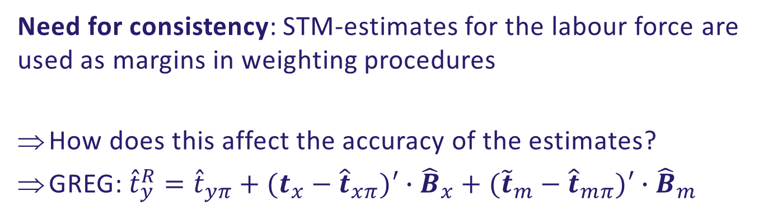
The problem at hand
Need for consistency: STM-estimates for the labour force are used as margins in weighting procedures
How does this affect the accuracy of the estimates?
GREG: ${\hat{t}}_{y}^{R}={\hat{t}}_{yπ}+(t_{x}−{\hat{t}}_{xπ})′∙{\hat{B}}_{x}+({\tilde{t}}_{m}−{\hat{t}}_{mπ})′∙{\hat{B}}_{m}$
Register total
STM- estimate

Slide 19
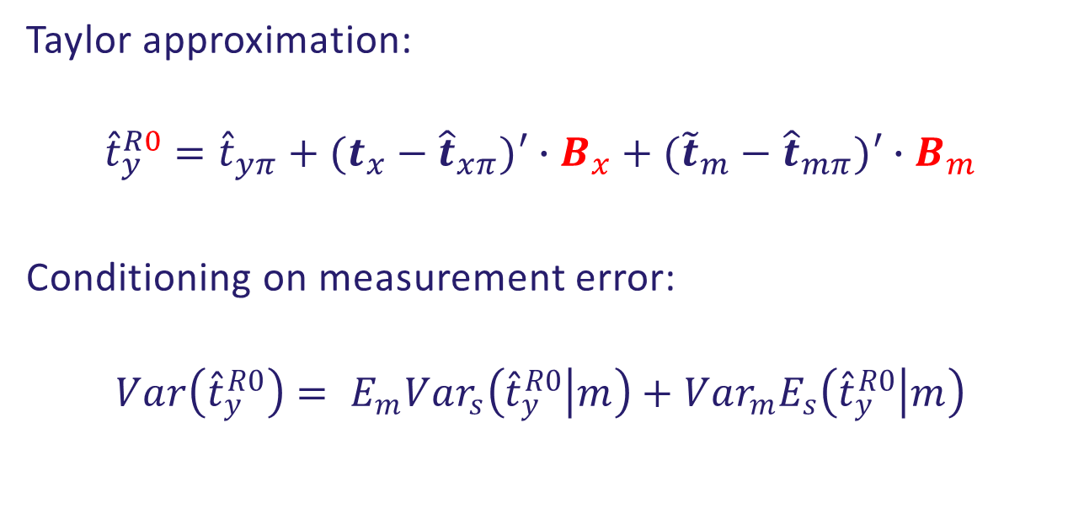
Variance estimates with STM-margins
Taylor approximation:
$${\hat{t}}_{y}^{R0}={\hat{t}}_{yπ}+(t_{x}−{\hat{t}}_{xπ})′∙B_{x}+({\tilde{t}}_{m}−{\hat{t}}_{mπ})′∙B_{m}$$
Conditioning on measurement error:
$$Var\left({\hat{t}}_{y}^{R0}\right)= E_{m}{Var}_{s}\left({\hat{t}}_{y}^{R0} | m\right)+{Var}_{m}E_{s}\left({\hat{t}}_{y}^{R0} | m\right)$$

Slide 20
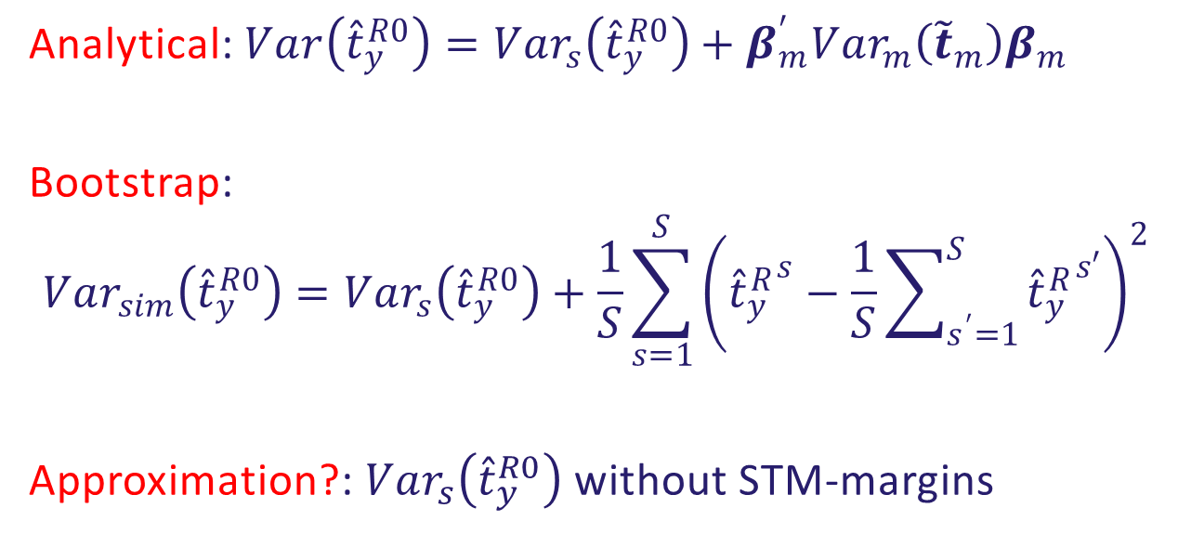
Variance estimates
Analytical: $Var\left({\hat{t}}_{y}^{R0}\right)={Var}_{s}\left({\hat{t}}_{y}^{R0}\right)+β_{m}^{′}{Var}_{m}\left({\tilde{t}}_{m}\right)β_{m}^{}$
Bootstrap:
$${Var}_{sim}\left({\hat{t}}_{y}^{R0}\right)={Var}_{s}\left({\hat{t}}_{y}^{R0}\right)+\frac{1}{S}\sum_{s=1}^{S}{{\left({{\hat{t}}_{y}^{R}}^{s}−\frac{1}{S}\sum_{s^{′}=1}^{S}{{{\hat{t}}_{y}^{R}}^{s′}}\right)}^{2}}$$
Approximation?: ${Var}_{s}\left({\hat{t}}_{y}^{R0}\right)$ without STM-margins

Slide 21
Thank you for your attention

