Slide 1


INCGROSS variable imputation & outlier treatment in the Luxemburgish LFS
Johann Neumayr
17TH WORKSHOP ON LABOUR FORCE SURVEY METHODOLOGY
Neuchâtel, 25–26 April 2024

Slide 2
Content
      Introduction
      Sources and chosen methods to estimate INCGROSS
      Item non response behavior for INCGROSS
      Modelling and Methodology
      Result and Analysis of the Imputation Process
      Impact of outlier treatment
      Conclusion

Slide 3
Survey Design in the LUX LSF
reference person sample
around 4.500 realized interviews per quarter
mixed mode design CAWI (80%) CATI (20%) since 2015
rotating panel with five waves
annual variables in first wave /household questions in third wave

Slide 4
What is asked in the survey?
no proxy IF STAPRO=3(employee)
What was your monthly gross income from your main job last month?
Gross income is your earnings before deductions such as taxes and social security contributions. Please also include any tips, commissions, meal allowances, mileage allowances, payments for overtime, monthly bonuses, or hazard pay, etc., that you received last month
Do you receive special payments?
e.g. 13th monthly salary, holiday or Christmas bonus
N
END
N
How high are the annual special payments in total? Please state the gross amount. An approximate estimate will suffice.
END
If you do not wish to enter the exact amount, please enter the category in which your gross monthly earnings from your main job were in the last month:
1: Less than 500 EURO
2: 500 to less than 1,000 EURO
3: 1,000 to less than 2,000 EURO
4: 2,000 to less than 3,000 EURO
5: 3,000 to less than 4,000 EURO
6: 4,000 to under 5,000 EURO
7: 5,000 to under 6,000 EURO
8: 6,000 to under 7,000 EURO
9: 7,000 to under 8,000 EURO
10: 8,000 to under 9,000 EURO
11: 9,000 to under 10,000 EURO
12: 10,000 to under 12,500 EURO
13: 12,500 to under 15,000 EURO
14: Over 15,000 EUR
Does the gross income of the last month that you have just stated include such special payments?
If so, how much was the special payment last month?
END

Slide 5
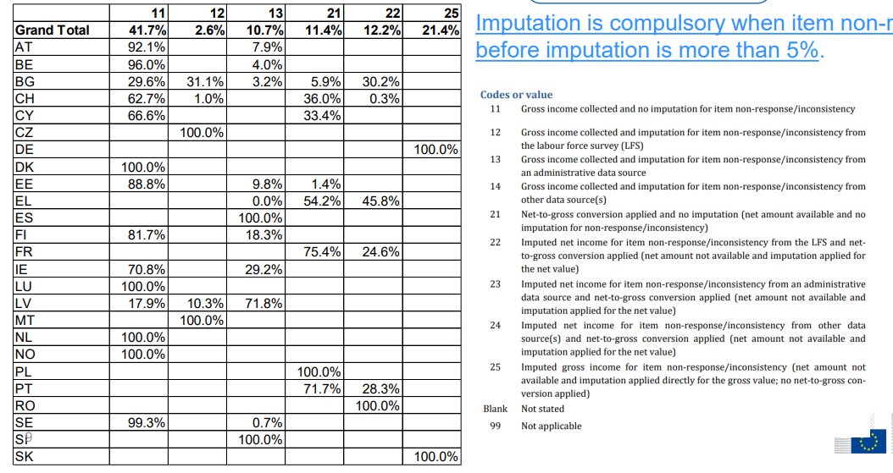
Sources and methods to estimate INCGROSS
11: INCGROSS collected and no imputation
12: INCGROSS collected & LFS imputation
13: INCGROSS collected & imputation from admin source
14: INCGROSS collected & imputation from other source
21: net gross conversion & no imputation
22: net income imputation from LFS & net gross conversion
23: net income imputation from admin source & net gross conversion
24: net income imputation from other source & net gross conversion
25: imputed gross income
  Imputation is compulsory
  when item non-response before imputation is more than 5%.
  Each country is free
  to choose the data source and method for imputation
Source: EUROSTAT

Slide 6
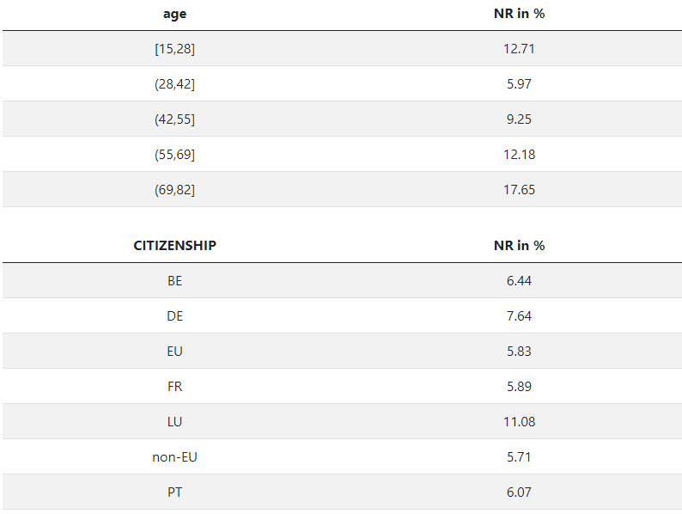
Item non response behavior for INCGROSS
Overall total non-response before imputation: 9%
Overall total non-response before imputation: 9%
Considerable differences for certain subgroups such as age and citizenship:

Slide 7
Item non response behavior for INCGROSS
Need for Action
Overall total non-response before imputation: 9%
Overall total non-response before imputation: 9%
Considerable differences for certain subgroups such as age and citizenship:
>5%

Slide 8
Sources and methods to estimate INCGROSS
11: INCGROSS collected and no imputation
12: INCGROSS collected & LFS imputation
13: INCGROSS collected & imputation from admin source
14: INCGROSS collected & imputation from other source
21: net gross conversion & no imputation
22: net income imputation from LFS & net gross conversion
23: net income imputation from admin source & net gross conversion
24: net income imputation from other source & net gross conversion
25: imputed gross income
  Why we choose imputation (only) to estimate INCGROSS:
  ● LFS is NOT the reference source on income
  ● Data linkage seems too labour-intensive for the moment
  Why we choose imputation (only) to estimate INCGROSS:
  ● LFS is NOT the reference source on income
  ● Data linkage seems too labour-intensive for the moment
Source: EUROSTAT

Slide 9
Modelling of the Imputation Process
  basic imputation using quickred() function from MICE() in R
        Selection of top predictor variables
        based on their performance from random forest analysis:
  FTPT, ISCO4D, YEARBIR, NACE3D, MIGREAS, HATLEVEL, HATYEAR, TEMP, CITIZENSHIP, SEX
Final definition of the imputation model for INCGROSS

Slide 10
Methodology
Default imputation methods from MICE():
(Multivariate Imputation by Chained Equations)
polytomous regression imputation (polyreg) for categorical variables
Logistic regression imputation for binary variables
predictive mean matching (pmm) for numeric variables

Slide 11
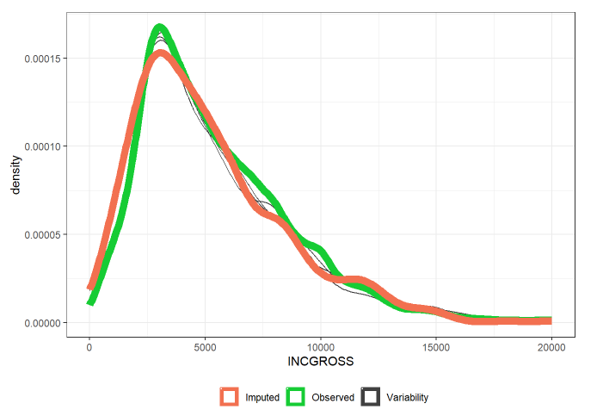
Result and Analysis of the Imputation Process:
Density distributions for INCGROSS

Slide 12
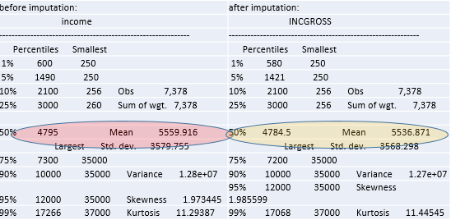
Impact of imputation
impact of imputing 9% missing values is minor

Slide 13
Outlier DETECTION
EUROSTAT PROPOSAL
Detection of possible outliers by Eurostat and treatment by the National Statistical Institutes
lower boundary: EXP [log Q1 – 3*(logQ3 – logQ1)] (208 EUR)
upper boundary: EXP [log Q3 + 3*(logQ3 – logQ1)] (97500 EUR)

Slide 14
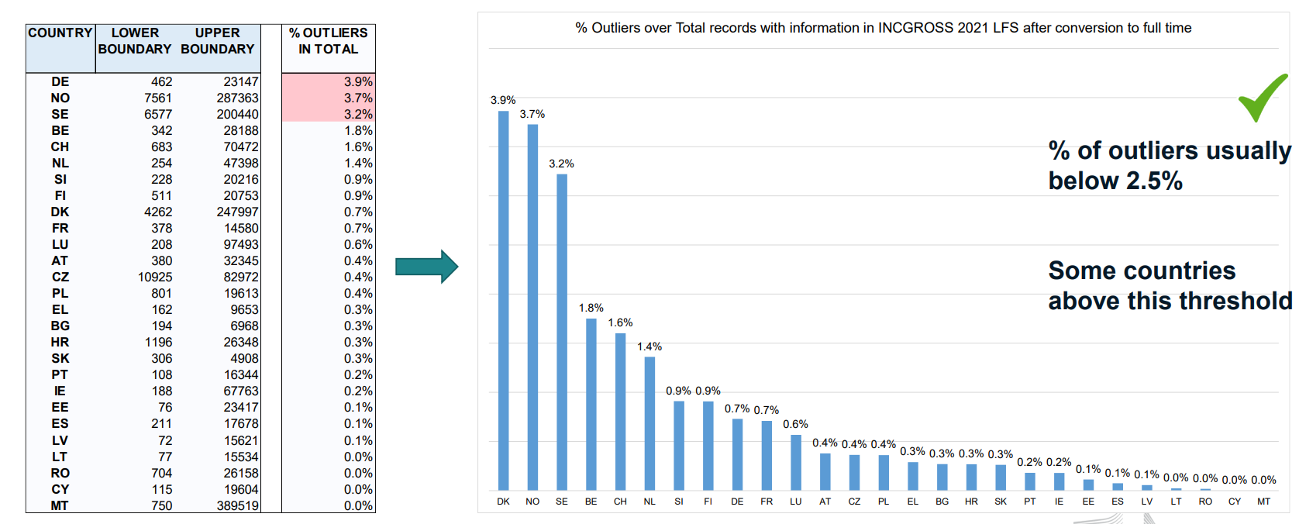
OUTLIER DETECTION ACROSS EUROPE
Source: Eurostat

Slide 15
Outlier treatment
(detection is not the problem…)
EUROSTAT PROPOSAL
Detection of possible outliers by Eurostat and treatment by the National Statistical Institutes
lower boundary: EXP [log Q1 – 3*(logQ3 – logQ1)] (208 EUR)
upper boundary: EXP [log Q3 + 3*(logQ3 – logQ1)] (97500 EUR)
OUR APPROACH
Lower boundary: trim values if HWUSUAL>30 & AGE>25& <INCGROSS (i.e. 2.5 SD) (statutory minimum wage!)
upper boundary : manually analyze cases if 2.5 SD from the mean
Transform 0 to blanks

Slide 16
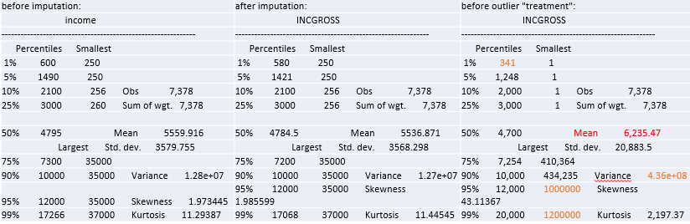
Impact of revised treatment of outliers:
impact of 1 %(!) outlier treatment is considerable

Slide 17
Conclusion
legal basis for the maximal item non-response for INCGROSS
the impact of treating 9% item non response (imputation) is minor
(currently) very limited discussion ground on an coordinated european level on the treatment of outliers
the impact of the outlier treatment (1%) is considerable

Slide 18
Johann Neumayr

