Slide 1

Design of data application for implementation of North Macedonian Labour Force survey
Neuchâtel, Switzerland, 25-26 April 2024
Daniela Avramoska, SSO

Slide 2
Content
1. Introduction
2. Workflow of LFS application
2.1 Application for data collection
2.2 Application for managing interviewing
3. Management application – modules
3.1 CAPI/CATI application
4. Conclusions

Slide 3
Introduction
Since 1996 LFS become a key element in social statistics with all relevant information that is disseminated for economic indicators.
From 1996 to 2011 paper questionnaires were the main form of data collection. In 2011, was started with CAPI and CATI mixed collection mode.
Under the IPA 2015 electronic mode of data collection was established again in 2017.

Slide 4
Workflow of LFS application
The design application as a tool for LFS data processing is a functional IT system for two main purposes:
Data collection and managing interviewing with integrated two modes of data collection CAPI and CATI;
Data management tools for field activities and supervisory tasks at Regional offices and SSO.

Slide 5

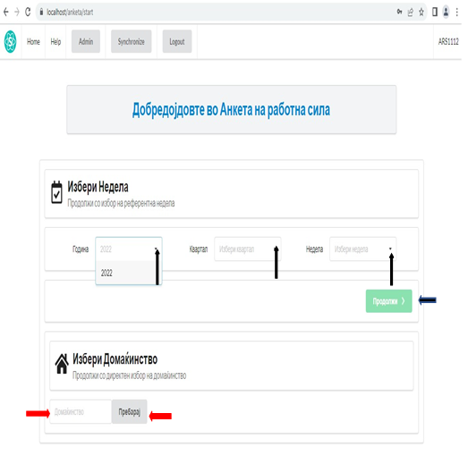
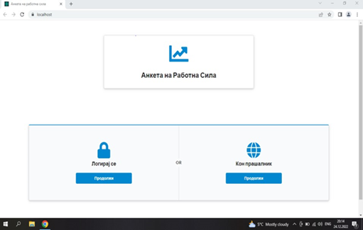
Application for data collection
The main functionalities
- Each interviewer has a list of interviews which has to be done;
- Filter is reporting period, available are current and previous week;
Notes:
Contains an electronic questionnaire for CAPI and CATI mode and a data entry form with built-in logical controls and validation rules

Slide 6
- There is household info, phone number, interview status, and appointment on the list;
- Function Make appointment opens the view to make an appointment for a specific date and time based on the status of the interview;
- Notifying the interviewer if there is an appointment coming up.

Slide 7
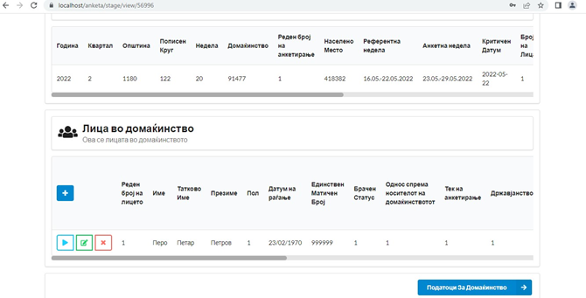
Notes:
1.

Slide 8
Application for managing interviewing in LFS
The developed management application is used by different users to complete different tasks.
The user's rights are adapted according to determinate actions allocated in the two modules.
The different roles are allocated to different users.
The following roles are determined: Manager, CATI controller, Regional coordinator, CATI Interviewer, CAPI Interviewer.

Slide 9
MANAGEMENT APPLICATION - MODULES
The management application is divided according to the user’s applicability into five modules:
USERS
REPORTING PERIODS (weeks)
ENUMERATION DISTRICTS
VIEW ENUMERATION DISTRICT DETAILS
REPORTS
Notes:
The first module where the main roles of all users are defined following management operational tasks is as an open gate to the system. According to the creating functionalities in this module, the Manager can effectively manage users within the system, including creating new users, editing existing user information, and ensuring that only active users have access to the system. Additionally, the system provides visibility into user data, such as first and last names, regions, roles, and active status, facilitating efficient user management.
In the module REPORTING PERIODS (weeks), the Manager can effectively manage reporting periods within the system, including creating new reporting periods, editing existing ones, and importing data from external sources. This setup provides comprehensive visibility and control over reporting period data.
By implementing the features and functionalities of management with viewing and operating enumeration district distribution, the system effectively supported the management of enumeration districts, assignment of interviewers, tracking of progress, and overall administration of the data collection.
The module of implementing features of viewing enumeration districts ensures the system provides detailed information and functionalities for managing and controlling interviews within the enumeration district. Users can efficiently edit, control, and update the status of interviews, as well as perform coding activities and manage data collection methods.
The functionalities of the module for viewing the calculation of interview salary help users to view detailed calculations of interview salary for each interviewer and provide necessary actions such as editing data or indicating that checks have been performed by relevant authorities.
The module of reports provides comprehensive insights into various aspects of the data collection process, including synchronization status, payment details, coding issues, control data, and unfinished interviews. Access control ensures that users can only view data relevant to their roles and regions.

Slide 10
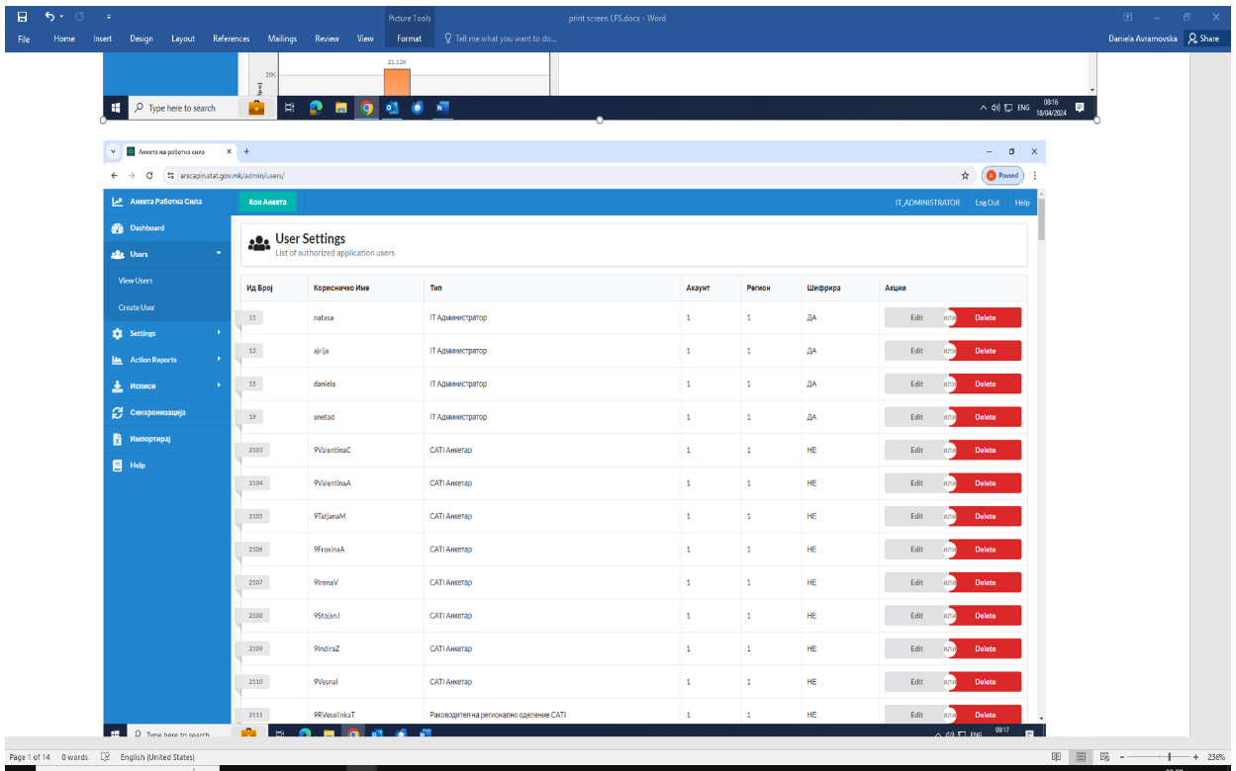
USERS
The first module where the main roles of all users are defined following management operational tasks is as an open gate to the system.
According to the creating functionalities in this module, the Manager can effectively manage users within the system, including creating new users, editing existing user information, and ensuring that only active users have access to the system.
The system provides visibility into user data, such as first and last names, regions, roles, and active status, facilitating efficient user management.

Slide 11
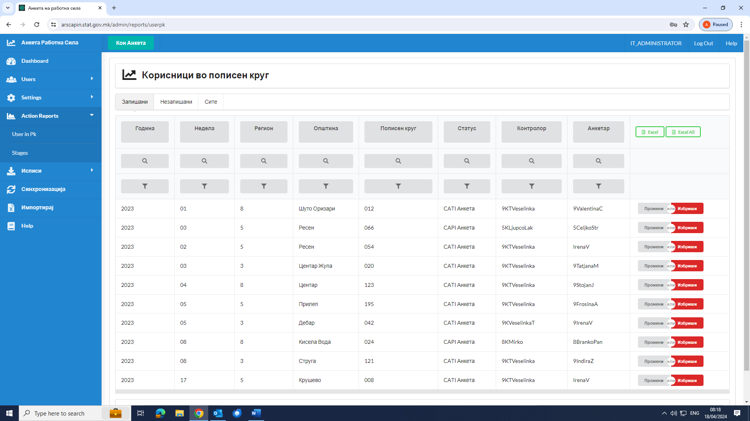
REPORTING PERIODS (weeks)
In the module the Manager can effectively manage reporting periods within the system, including creating new reporting periods, editing existing ones, and importing data from external sources.

Slide 12
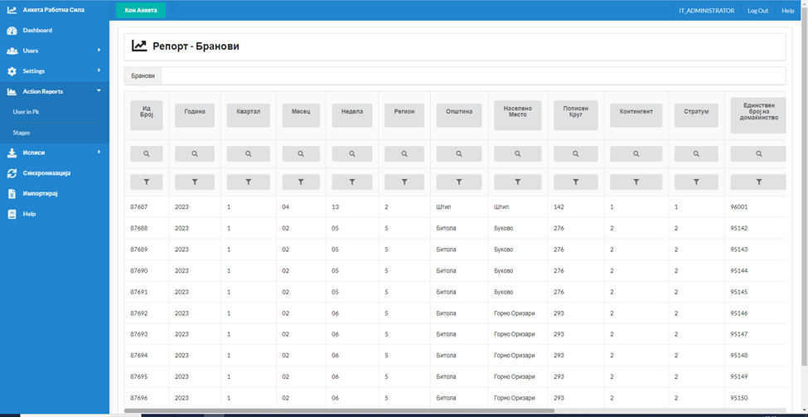
ENUMERATION DISTRICTS
The module of implementing features of viewing enumeration districts ensures the system provides detailed information and functionalities for managing and controlling interviews within the enumeration district. Users can efficiently edit, control, and update the status of interviews, as well as perform coding activities and manage data collection methods.

Slide 13
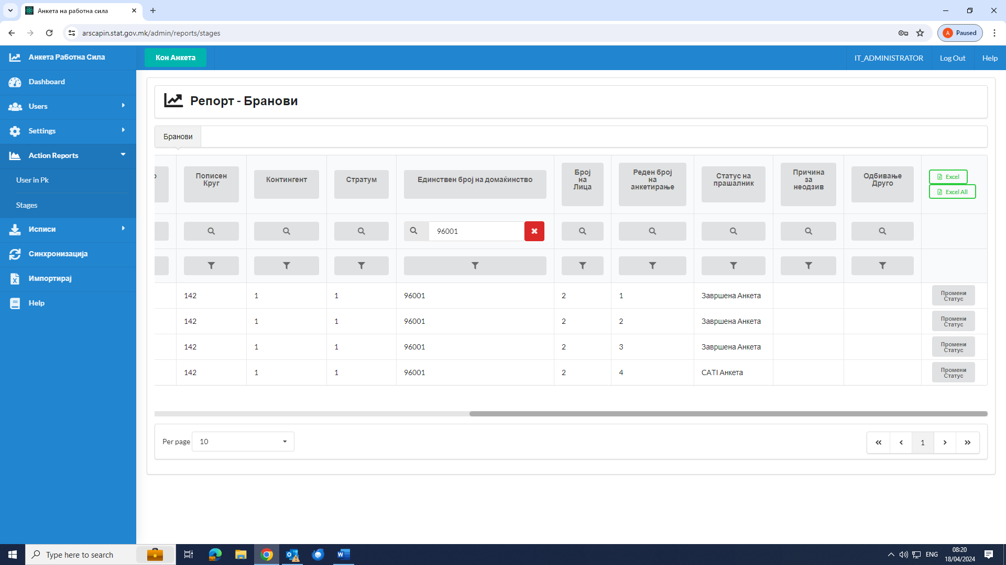
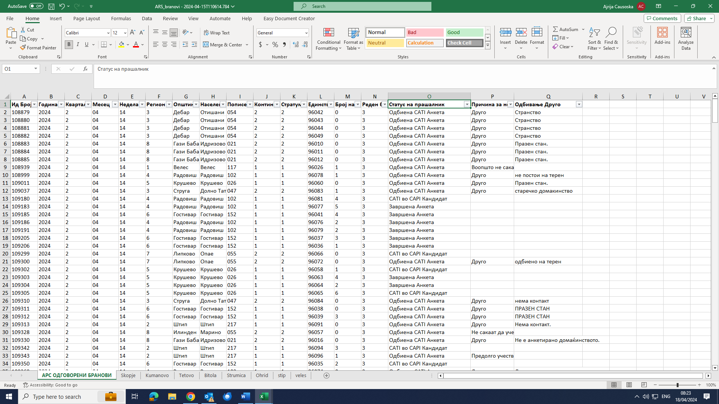
REPORTS
The module of reports provides comprehensive insights into various aspects of the data collection process, including synchronization status, coding issues, control data, and unfinished interviews. Access control ensures that users can only view data relevant to their roles and regions.

Slide 14
MANAGEMENT APPLICATION - MODULES
The part of the application for CAPI/CATI interweaving includes functionalities that are responsible for ensuring LFS interweaving. This module includes the following function divided according to the type of activities used:
List of Interviews;
Functions;
Adding New Household;
Synchronize Data.

Slide 15
Conclusions
production in January 2021 and,
modifying to the end of 2023, including ad-hoc module for 2024.
Advantages
- further processing in checking and controlling;
active communication with interweavers and continuous monitoring of the process of filling in electronic form questionnaires and requirements for data corrections.
give time cost efficient work because process of data entry after field work is eliminated;
incorporated validation rules for respondent’s answers who improve data quality of the survey;
controlling process is on high level quality ;
Notes:
Too many direct and sensitive questions (depending on the frequency, the difficulty of traumatic experiences, and the respondent's openness and the degree of processing these experiences).
Questions on fear and responses to fear of victimization should be added (avoiding certain public spaces for fear of sexual harassment).
In the section on sexual violence, a question should be added about the prohibition on the use of contraceptives as a form of violence.
Finally, it is good to include a short questionnaire (ex. 5-6 questions), which will be completed by the respondent herself without being asked by the interviewer.

Slide 16
Conclusions
accelerated time of running data report from the interviewing with immediate access to results. System ensure access to data in the period during interviewing and the methodological staff controllers can have and control data reports in the process of field work.
Disadvantages
defining the status of the household in front of the fieldwork;
finalization of the interviewing household and individual records;
list of the answered questions that appear on the screen, with the possibility to return;
further developed to meet recent changing needs and expectations.

Slide 17

Thanks and questions
Daniela.avramoska@stat.gov.mk

