Slide 1
Design of national questionnaires for the eight-yearly EU-LFS modules – using the example of the 2023 module on pensions and labour market participation
Christian Hutter, Swiss Federal Statistical Office (SFSO)
17th EU-LFS methodology workshop
Neuchâtel, Switzerland
25 April 2024

Slide 2
Table of contents
National “customization” of Eurostat’s model questionnaires
Swiss version of the 2023 pensions module:
Adaptation to the Swiss pension system
Adaptation to additional data needs at the national level
Conclusions and discussion

Slide 3
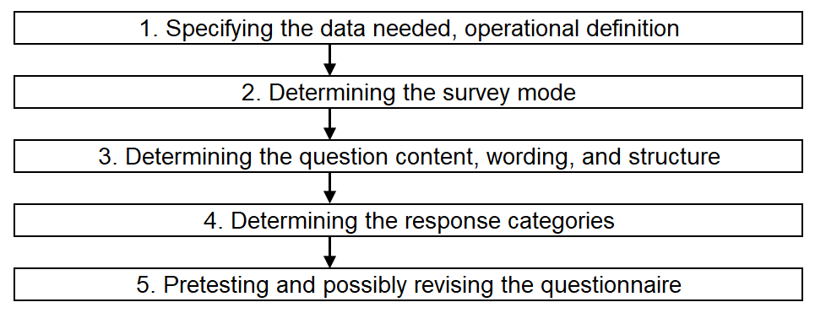
National “customization” of Eurostat’s model questionnaires
The main steps in the process of questionnaire design (adapted from Brancato et al. 2006, 13-58):

Slide 4
National “customization” of Eurostat’s model questionnaires
First cycle of implementation 2021-2028
Model questionnaires as a common ground
fit-for-all
space for adaptations
Need for customization due to national circumstances
additional data need at the national level
technical aspects of the national LFS
institutional factors
cultural factors

Slide 5
National “customization” of Eurostat’s model questionnaires
Eight-yearly EU-LFS module on pensions and labour market participation
Complex module topic
technical matter
some people lack awareness of their situation
Differences in national pension system setups
legal differences
terminological differences
Additional data need at the national level

Slide 6
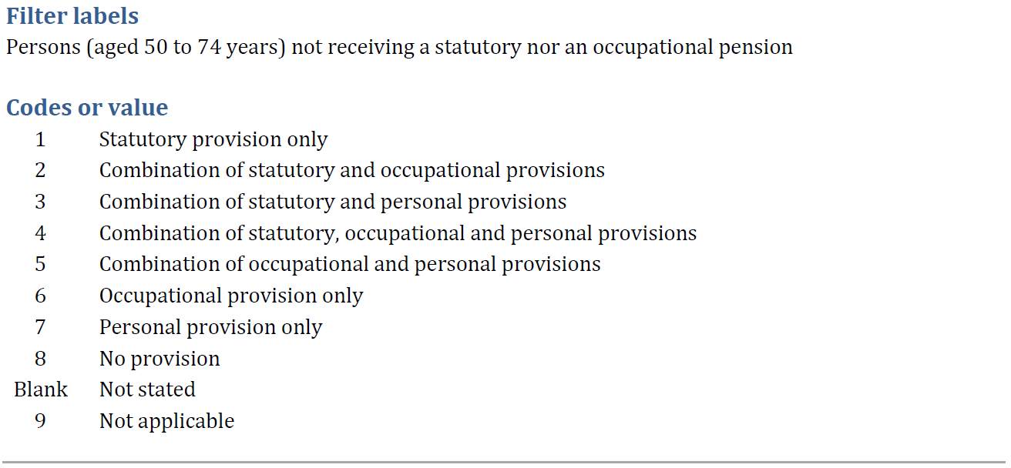
Adaptation of the module to the Swiss pension system

Slide 7
Adaptation of the module to the Swiss pension system
Since 1946, all physical persons residing in Switzerland are entitled to a statutory old age pension and are obliged to pay respective contributions
only codes 1 to 4 of PROVTYPE are applicable in the Swiss LFS
the PROVTYPE question about a statutory pension was not asked

Slide 8
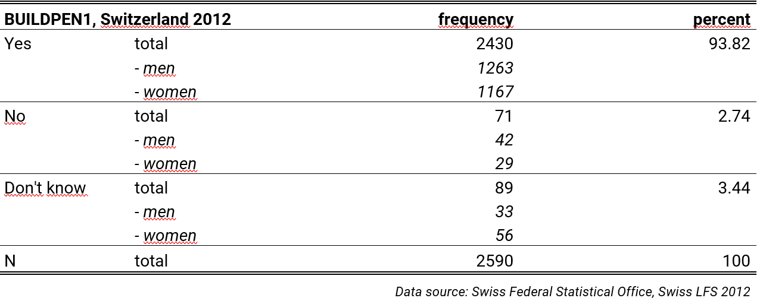
Adaptation of the module to the Swiss pension system
In the previous, 2012 version of the module, the corresponding question had been asked, although it was actually redundant
6.2 percent of the respondents answered «no» or «don’t know»

Slide 9
Adaptation of the module to additional data needs
A former national LFS module on the same topic has been discontinued due to:
newly gained access to register data
partial overlap with the EU-LFS module
«A few extra questions» were added to the EU-LFS module instead
Differentiation between Swiss pensions and pensions from abroad
Questions on lump-sum payments from old-age insurances

Slide 10
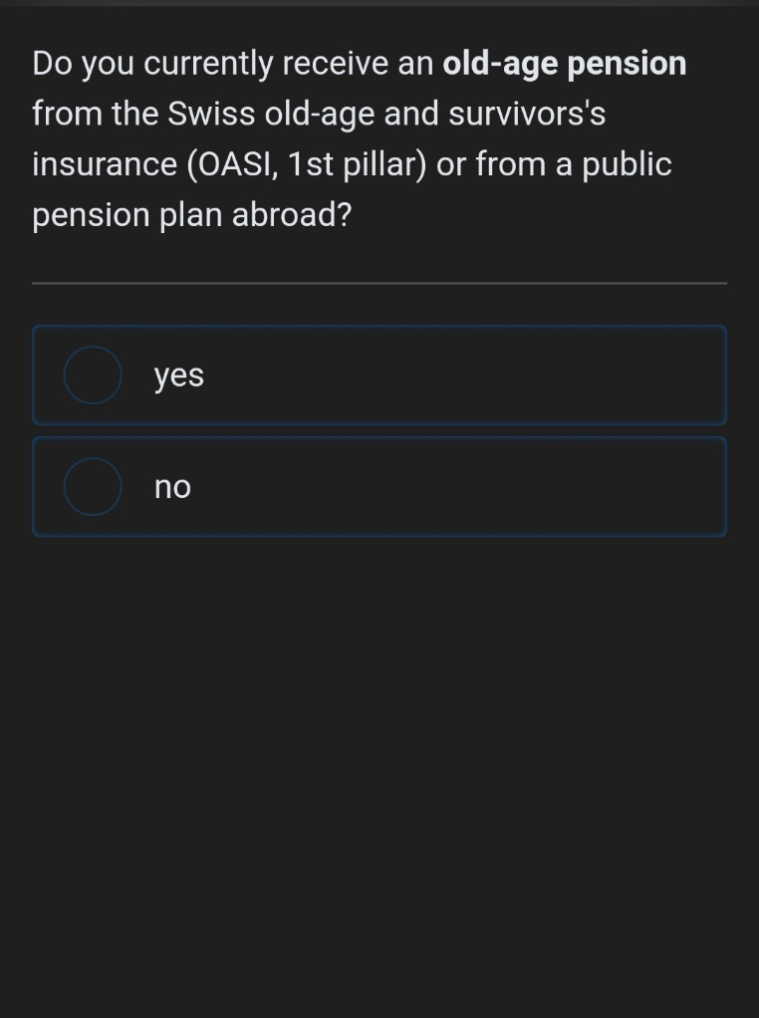
Adaptation of the module to additional data needs
Differentiation between Swiss pensions and pensions from abroad: PENSTYP

Slide 11
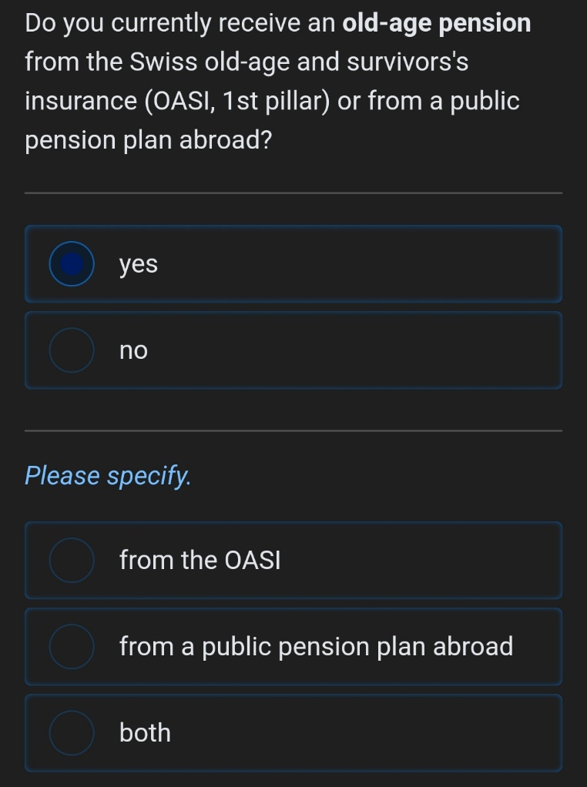
Adaptation of the module to additional data needs
Differentiation between Swiss pensions and pensions from abroad: PENSTYP

Slide 12
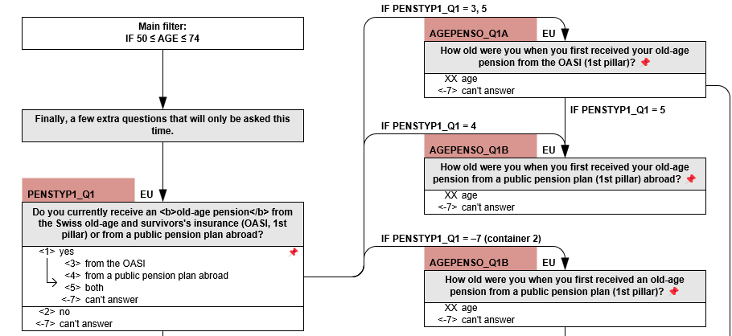
Adaptation of the module to additional data needs
Differentiation between Swiss pensions and pensions from abroad: AGEPENSO

Slide 13
Adaptation of the module to additional data needs
Differentiation between Swiss pensions and pensions from abroad
Additional information on lump-sum payments from old-age insurances
Total of 39 question as compared to 23 questions in Eurostat’s model
Little impact on the individual response burden, but …
… considerable impact on the complexity of questionnaire routing and data processing!

Slide 14
Conclusions
Due to the high level of detail of the modules’ topics, some sort of customization is often unavoidable in order to make them work in a specific national environment.
These adaptations can potentially concern all stages of the process of questionnaire design and confront NSIs with numerous and sometimes tricky challenges.
A more regular, more institutionalized exchange of experience on this topic could be fruitful for all.

Slide 15
Thank you for your attention and have a nice stay in Neuchâtel!

